Slide 1
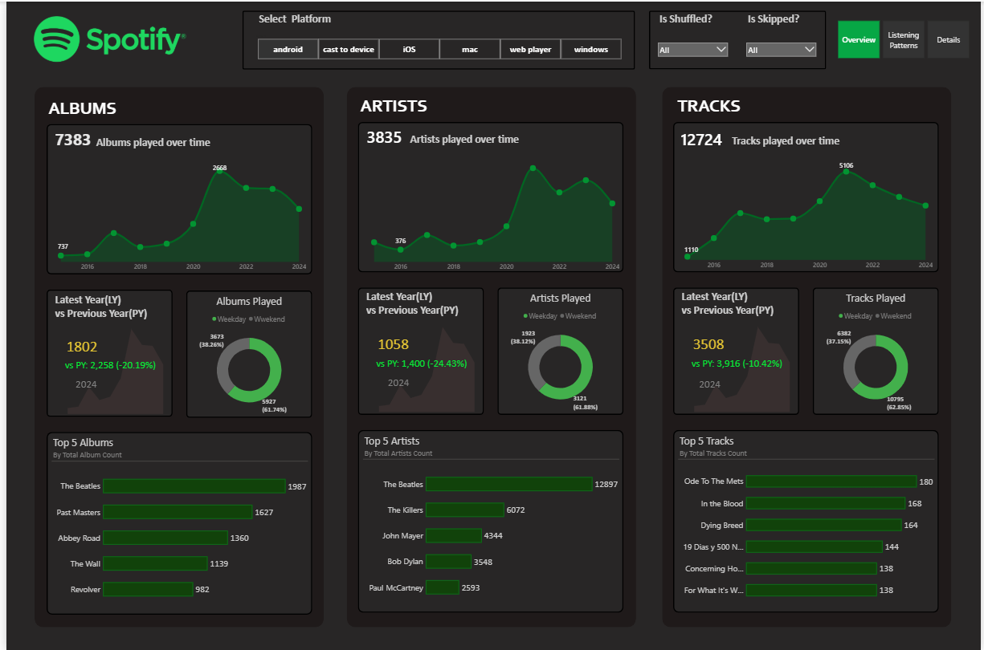

Slide 2
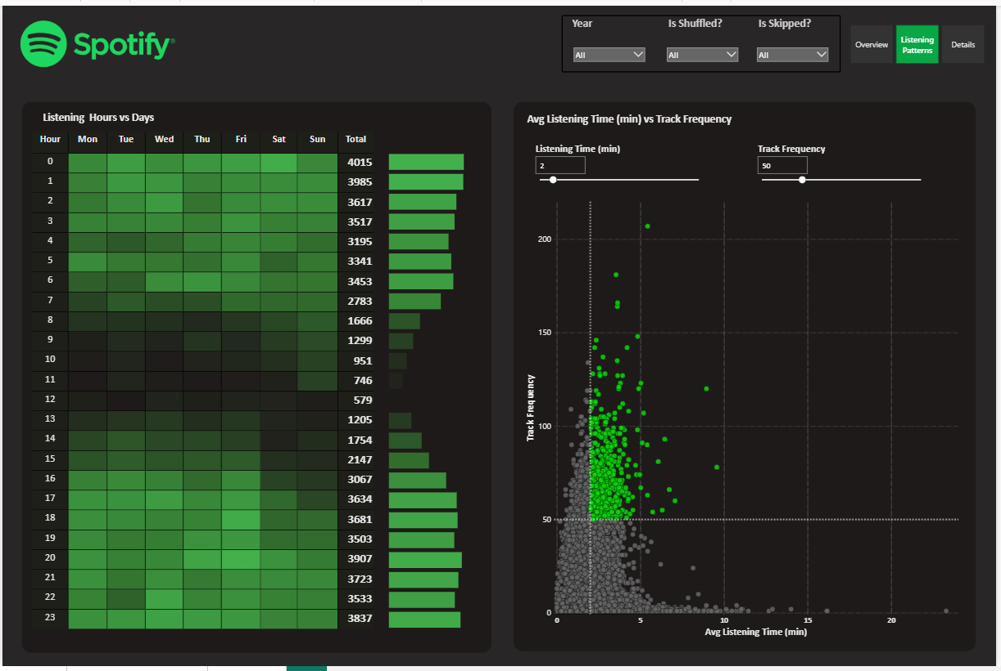

Slide 3
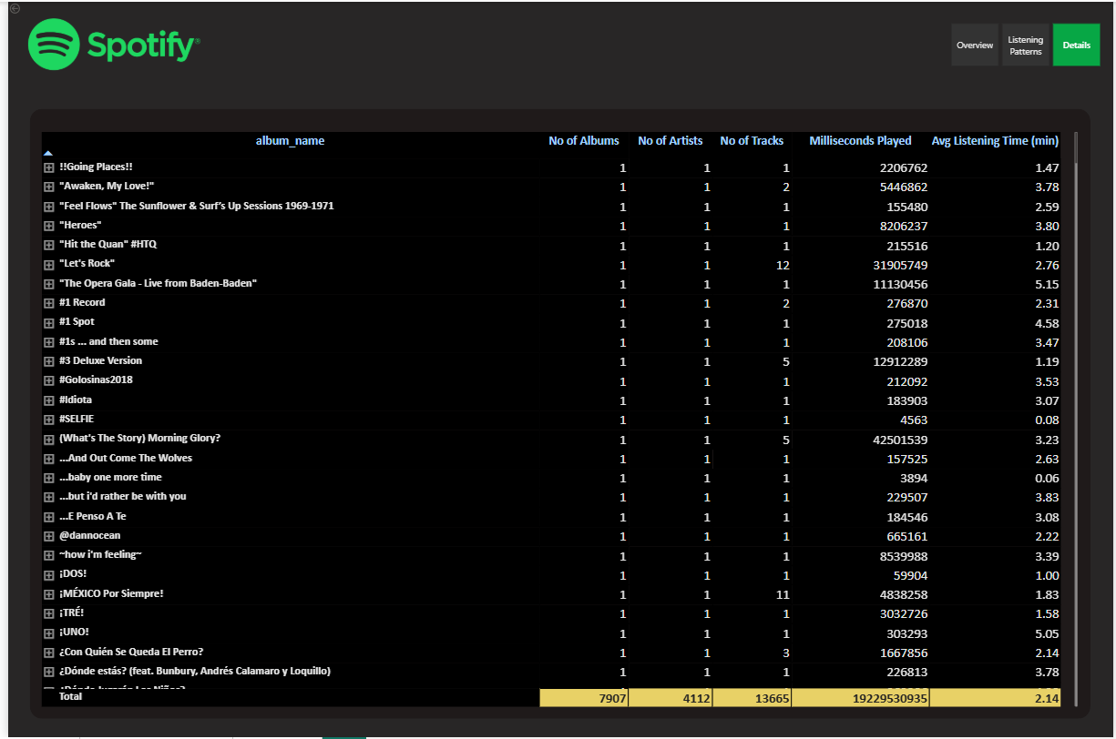

Slide 4

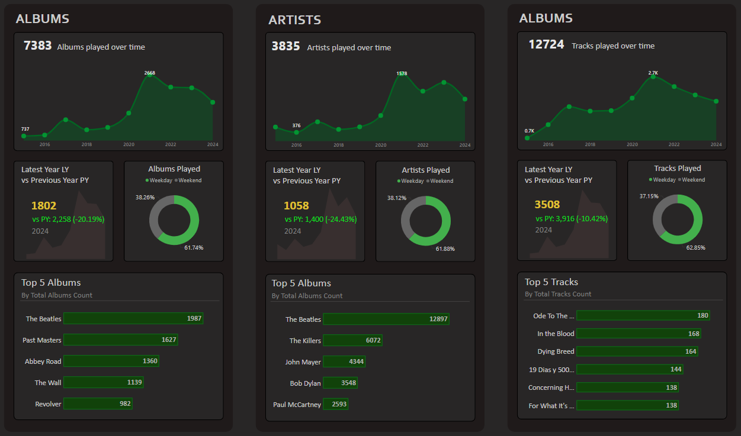


STEPS IN PROJECT
Requirement Gathering/ Business Requirements
Data Walkthrough
Data Connection
Data Cleaning / Quality Check
Data Modeling
Data Processing
DAX Calculations
Dashboard Lay outing
Charts Development and Formatting
Dashboard / Report Development
Insights Generation

Slide 5
BUSINESS REQUIREMENT
In today’s digital music era, understanding listening patterns is crucial for both users and streaming platforms. This analysis focuses on Spotify Albums Data, providing insights into user engagement with albums over time.
ALBUMS
🎵 Total Albums Played Over Time – Track how album listening trends change over months and years.
📅 Number of Albums Listened by Year – Identify annual listening habits and volume (Find the Min and Max Albums in the view).
💥Albums Played on Weekday & Weekend – Identify the Pattern of music listening on weekdays and weekends.
🏆 Top 5 Albums – Identify the most played albums based on listening frequency.
📊 Latest Year vs Previous Year Analysis – Compare album consumption between the latest and previous years, including:
  LY (Latest Year) vs PY (Previous Year) Trends
  YoY (Year-over-Year) Growth Analysis

Slide 6
BUSINESS REQUIREMENT
ARTISTS
🎵 Total Artists Played Over Time – Track how artist listening trends evolve across months and years.
📅 Number of Artists Listened by Year – Identify annual listening habits and artist diversity. (Find the Min and Max Artists in the view).
💥Artists Played on Weekday & Weekend – Identify the Pattern of music listening on weekdays and weekends.
🏆 Top 5 Artists – Identify the most played artists based on listening frequency.
📊 Latest Year vs Previous Year Analysis – Compare artist engagement between the latest and previous years, including:
  LY (Latest Year) vs PY (Previous Year) Trends
  YoY (Year-over-Year) Growth Analysis

Slide 7
BUSINESS REQUIREMENT
TRACKS
🎵 Total Tracks Played Over Time – Monitor how track listening trends change across months and years
📅 Number of Tracks Listened by Year – Identify annual listening habits and track diversity. (Find the Min and Max Tracks in the view).
💥Tracks Played on Weekday & Weekend – Identify the Pattern of music listening on weekdays and weekends.
🏆 Top 5 Tracks – Identify the most played tracks based on listening frequency.
📊 Latest Year vs Previous Year Analysis – Compare track engagement between the latest and previous years, including:
  LY (Latest Year) vs PY (Previous Year) Trends
  YoY (Year-over-Year) Growth Analysis

Slide 8
BUSINESS REQUIREMENT
LISTENING PATTERNS
🕒 Listening Hours Analysis – Identify peak listening times using a Heat Map that visualizes patterns across hours and days with color intensity.
📊 Average Listening Time (min) vs Track Frequency – Use a Scatter Plot with Quadrant Analysis to categorize tracks based on:
  High Frequency & High Listening Time – Most engaging tracks 🎯
  Low Frequency & High Listening Time – Niche but impactful tracks
  High Frequency & Low Listening Time – Short & frequently played tracks
  Low Frequency & Low Listening Time – Less popular tracks

Slide 9
BUSINESS REQUIREMENT
DETAILS GRID
In this report, we aim to analyze Spotify data by creating an interactive and dynamic Grid View. The Grid will display key details such as Album Name, Artist Name, Track Name, and other relevant attributes.
Key Requirements:
Grid View with Essential Fields:
  The Grid should present critical data points for an intuitive and structured view.
2. Drill Through Functionality:
  Users should be able to drill through from the main reports to explore underlying data for detailed insights.
  The drilled-through data should be exportable to a CSV file based on user requirements.
3. Drill Down, Drill Up, and Hierarchy:
  The Grid should support hierarchical navigation, allowing users to drill down and up for in-depth data exploration.

